Slide 1
IBM Data Analyst Capstone Project: Analysis on Emerging Technology Skills and Trends Presented by Leon Finn Borchert 27.10.2024

Slide 2







Outline
Executive Summary
Introduction
Methodology
Results Visualization – Charts
Discussion Findings & Implications
Conclusion
Appendix
*Icons used from icons8.de

Slide 3
Executive Summary
This report analyzes data collected from a Stack Overflow survey, IBM resources, and job postings on GitHub. Following meticulous data cleaning and exploratory analysis, the findings are presented through interactive dashboards. Key findings indicate that JavaScript remains the leading programming language and is projected to maintain its dominance in the future. In the realm of database technologies, MySQL is currently the most widely used, while PostgreSQL is anticipated to gain popularity. Demographic analysis reveals that the majority of respondents are male, primarily located in the USA, with an average age of 28. This report provides valuable insights for businesses and professionals seeking to align with current industry trends and remain at the forefront of IT development.

Slide 4
Introduction
This data analytics presentation reports both current and future trends in key IT skills related to programming languages, databases, platforms, and web frameworks. The analysis addresses the following critical questions:
Which programming languages are most in demand today?
What are the top database skills in demand?
Which Integrated Development Environments are the most popular?
"Additionally, the report explores demographic trends within the IT workforce, including gender distribution, average age, education level, and country. These insights aim to help professionals and businesses align their skills and strategies with evolving industry demands."

Slide 5
Methodology
The methodology of this study involves several steps for data collection and analysis.
First, we scrape internet websites and access APIs to collect data in various formats, such as .csv files, Excel sheets, and databases.
After data collection, we perform data wrangling techniques to prepare the data for analysis.
Once the data is ready, we apply statistical techniques to conduct in-depth analyses.
We then consolidate all information using Google Looker Studio to create a visually engaging dashboard.
Finally, we share our findings in a presentation, utilizing storytelling skills to effectively communicate the key results.

Slide 6
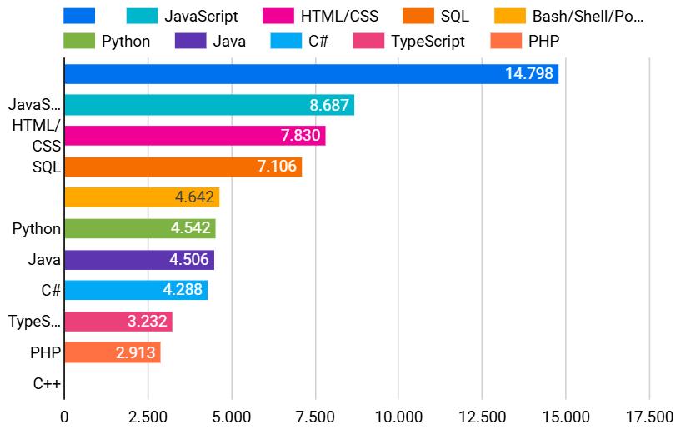
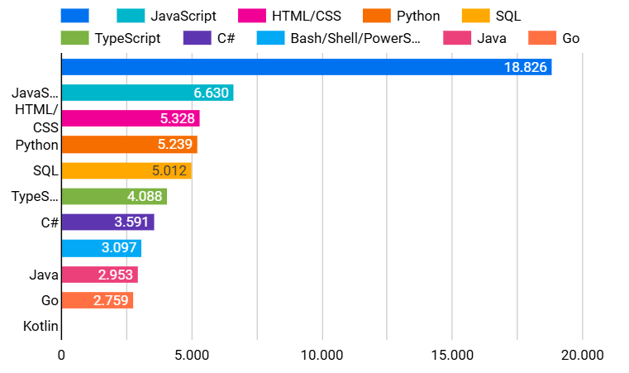
Results – Programming Language Trends
Top 10 Languages Worked With
Top 10 Languages for the Next Year
Dashboard available at https://lookerstudio.google.com/reporting/0f58c0c5-4a79-4543-b035-6a8f21b45094

Slide 7
Findings & Implications – Programming Language Trends
Findings
Implications
The most commonly used languages are JavaScript, HTML, CSS, SQL, shell scripting languages, and Python.
JavaScript, HTML, CSS, SQL, and Python are expected to be the most in-demand programming languages in the future.
The demand for Python is anticipated to surpass that of SQL in the coming years.
Focus on JavaScript, HTML, CSS, SQL, and Python to stay competitive.
Educational programs should prioritize these languages to meet future industry needs.
Companies may invest in Python training for staff to support data science and automation.

Slide 8
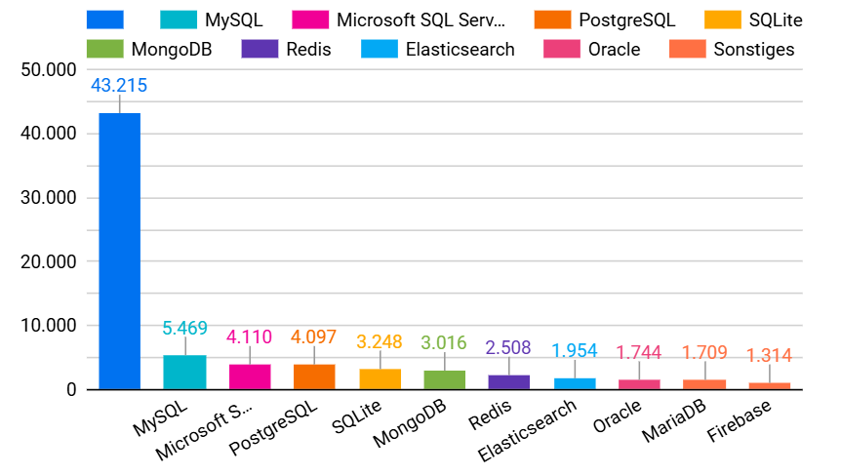
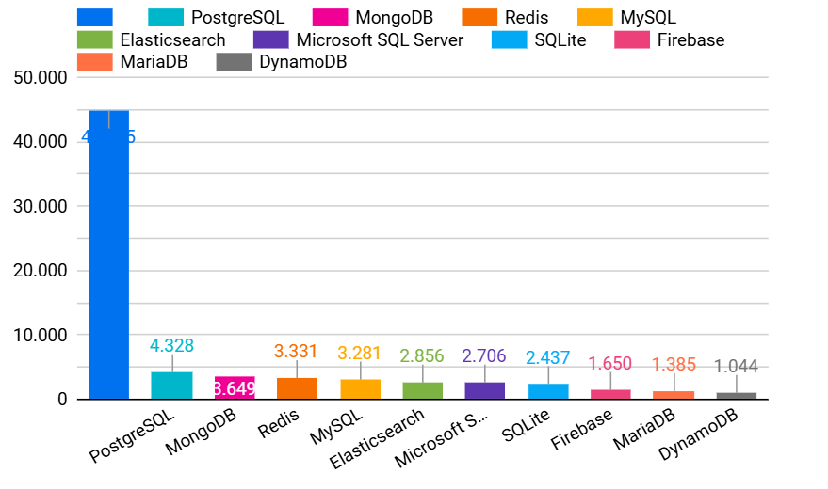
Results – Database Trends
Top 10 Databases Worked With
Top 10 Databases for the Next Year
Dashboard available at https://lookerstudio.google.com/reporting/0f58c0c5-4a79-4543-b035-6a8f21b45094

Slide 9
Findings & Implications – Database Trends
Findings
Implications
MySQL, Microsoft SQL Server, PostgreSQL, SQLite, and MongoDB are the most commonly used databases.
In the future, the three most in-demand databases will be PostgreSQL, MongoDB, and Redis, followed by MySQL and Elasticsearch.
Skill Development: Professionals should focus on PostgreSQL, MongoDB, and Redis for future demand.
Training Focus: Educational programs should emphasize these databases alongside MySQL and Elasticsearch.
Company Resources: Businesses might prioritize PostgreSQL, MongoDB, and Redis in their infrastructure.

Slide 10
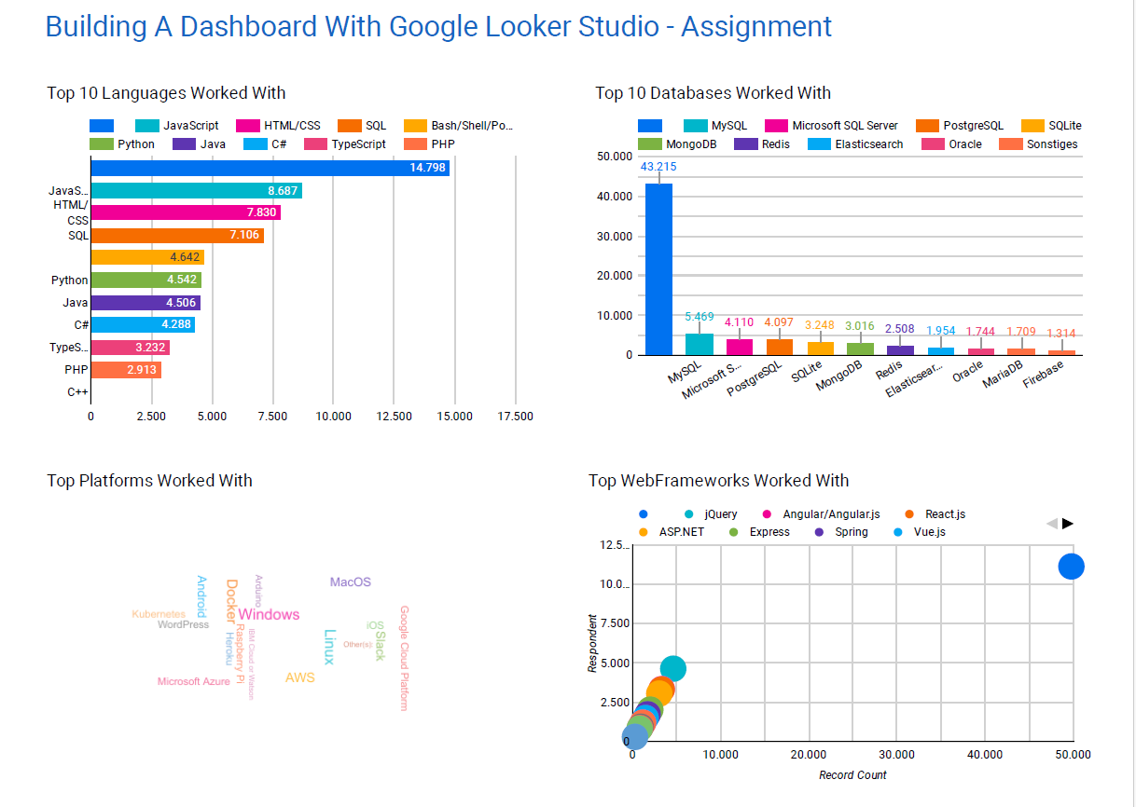
Dashboard – Current Technology Usage
Dashboard available at https://lookerstudio.google.com/reporting/0f58c0c5-4a79-4543-b035-6a8f21b45094

Slide 11
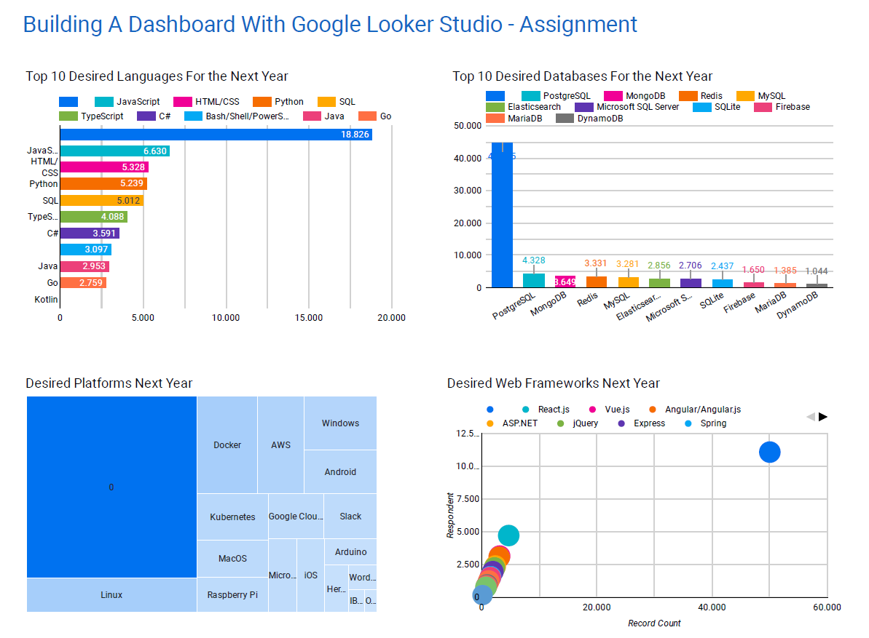
Dashboard – Future Technology Trend
Dashboard available at https://lookerstudio.google.com/reporting/0f58c0c5-4a79-4543-b035-6a8f21b45094

Slide 12
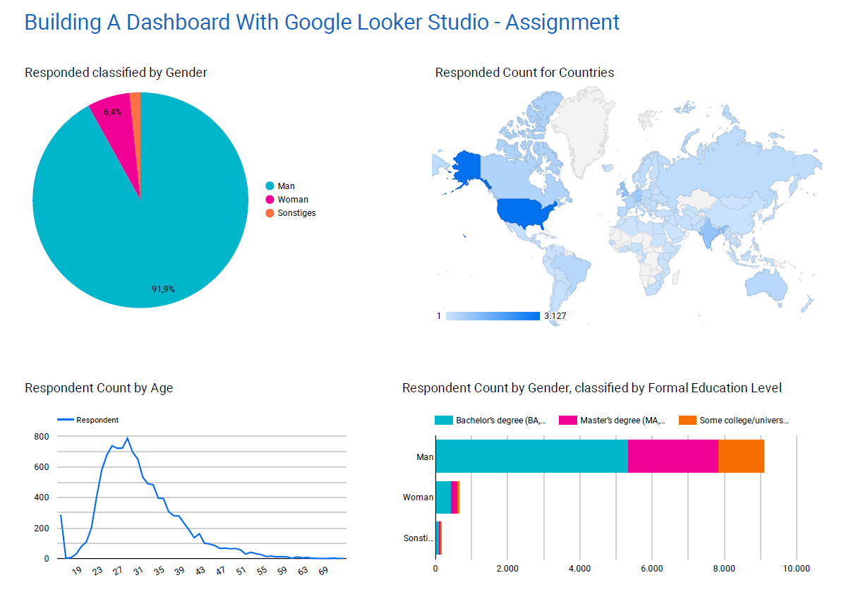
Dashboard – Demographics
Dashboard available at https://lookerstudio.google.com/reporting/0f58c0c5-4a79-4543-b035-6a8f21b45094

Slide 13


Discussion – Programming Languages and Databases
Programming Languages
Databases
The most commonly used languages are JavaScript, HTML, CSS, SQL, shell scripting languages, and Python.
JavaScript, HTML, CSS, SQL, and Python are expected to be the most in-demand programming languages in the future.
The demand for Python is anticipated to surpass that of SQL in the coming years.
Skill Development: Professionals should focus on PostgreSQL, MongoDB, and Redis for future demand.
Training Focus: Educational programs should emphasize these databases alongside MySQL and Elasticsearch.
Company Resources: Businesses might prioritize PostgreSQL, MongoDB, and Redis in their infrastructure.
Which programming languages will be the most prominent in the future?
Which databases will be the most prominent in the future?
*Icons used from icons8.de

Slide 14



Discussion – Country Origin and Backround
Country Origin
Most of the surveyed participants are from North America, followed by India, Europe, China and some South American countries.
What are the emerging countries and what factors contribute to their rise?
Gender & Age
Why is there still such a large gender gap in the IT sector?
92% of the surveyed participants are male.
Most of the surveyed participants are between 23 and 35 years old.
Education
What level of education is required for a career in the IT field?
More than 85% of the surveyed participants have at least a Bachelor Degree.
*Icons used from icons8.de

Slide 15
Conclusion
In conclusion, the findings reveal key trends in the IT sector, with JavaScript, HTML, CSS, SQL, and Python being the most commonly used languages.
Notably, Python's demand is expected to surpass that of SQL, while PostgreSQL, MongoDB, and Redis are emerging as essential databases for the future.
The demographic data indicates a predominance of young males from North America, with over 85% holding at least a Bachelor’s degree, highlighting a lack of diversity in the field.
These insights emphasize the need for strategic skill development, targeted training, and inclusive hiring practices to strengthen the IT workforce.

